Slide 1
L-Curve Analysis with Varied Network Sizes, Optimization Parameters, and Data
GRNmap Data Analysis Team
Last Updated: 09/19/17

Slide 2
L-Curve Graphing Methodology
The L-Curves.R script available on the Dahlquist Lab GitHub repository was used.
https://github.com/kdahlquist/DahlquistLab/blob/master/R_scripts/L-Curves.R
The axes for all graphs in this data set were standardized based on overall minimum and maximum Penalty Term and LSE values.
Penalty Term: [0, 20.5]
LSE: [0.55, 1.1]
Alpha values were not displayed (issue with overlap) but can be inferred from the sequencing of data points.
Experiments were performed using the network “db5”.

Slide 3
Experiment I: Impact of Missing Values

Slide 4
db5: No Missing Values 15-genes_28-edges_db5_Sigmoid_estimation_no-missing-values_L-curve

Slide 5
db5: Missing Values 15-genes_28-edges_db5_Sigmoid_estimation_missing-values_L-curve

Slide 6
Missing Values Results for db5

Slide 7
Experiment II: Varied Optimization Parameters

Slide 8
db5: Missing Values (Baseline) 15-genes_28-edges_db5_Sigmoid_estimation_missing-values_L-curve

Slide 9
db5: fix b 15-genes_28-edges_db5_Sigmoid_estimation_missing-values_fixb

Slide 10
db5: fix P 15-genes_28-edges_db5_Sigmoid_estimation_missing-values_fixP

Slide 11
db5: Fix b and P 15-genes_28-edges_db5_Sigmoid_estimation_missing-values_fixP-fixb

Slide 12
Varied Optimization Parameters Results for db5

Slide 13
Optimization of db5 Production Rates During Fix b L-Curve Run

Slide 14
Experiment III: Varied Strain Data

Slide 15
db5: All Strain Data (Baseline) 15-genes_28-edges_db5_Sigmoid_estimation_missing-values_L-curve

Slide 16
db5: No GLN3 Data 15-genes_28-edges_db5_Sigmoid_estimation_missing-values_L-curve_no-GLN3-data

Slide 17
db5: No GLN3, ZAP1 Data 15-genes_28-edges_db5_Sigmoid_estimation_missing-values_L-curve_no-GLN3-ZAP1-data

Slide 18
db5: No GLN3, ZAP1, HAP4 Data 15-genes_28-edges_db5_Sigmoid_estimation_missing-values_L-curve_no-GLN3-ZAP1-HAP4-data

Slide 19
db5: No GLN3, ZAP1, HAP4, HMO1 Data 15-genes_28-edges_db5_Sigmoid_estimation_missing-values_L-curve_no-GLN3-ZAP1-HAP4-HMO1-data

Slide 20
db5: No GLN3, ZAP1, HAP4, HMO1, CIN5 Data 15-genes_28-edges_db5_Sigmoid_estimation_missing-values_L-curve_no-GLN3-ZAP1-HAP4-HMO1-CIN5-data

Slide 21
Varied Strain Data Results for db5

Slide 22
Experiment IV: Varied Network Size

Slide 23
db5: 15 Genes, 28 Edges (Baseline) 15-genes_28-edges_db5_Sigmoid_estimation_missing-values_L-curve

Slide 24
db5: 14 Genes, 27 Edges (dGLN3) 14-genes_27-edges_db5_Sigmoid_estimation_missing-values_dGLN3

Slide 25
db5: 13 Genes, 26 Edges (dZAP1) 13-genes_26-edges_db5_Sigmoid_estimation_missing-values_dGLN3-dZAP1

Slide 26
db5: 12 Genes, 25 Edges (dGCR2) 12-genes_25-edges_db5_Sigmoid_estimation_missing-values_dGLN3-dZAP1-dGCR2

Slide 27
db5: 11 Genes, 24 Edges (dACE2) 11-genes_24-edges_db5_Sigmoid_estimation_missing-values_dGLN3-dZAP1-dGCR2-dACE2

Slide 28
db5: 10 Genes, 22 Edges (dSWI5) 10-genes_22-edges_db5_Sigmoid_estimation_missing-values_dGLN3-dZAP1-dGCR2-dACE2-dSWI5

Slide 29
db5: 9 Genes, 20 Edges (dASH1) 9-genes_20-edges_db5_Sigmoid_estimation_missing-values_dGLN3-dZAP1-dGCR2-dACE2-dSWI5-dASH1

Slide 30
db5: 8 Genes, 17 Edges (dYOX1) 8-genes_17-edges_db5_Sigmoid_estimation_missing-values_dGLN3-dZAP1-dGCR2-dACE2-dSWI5-dASH1-dYOX1

Slide 31
db5: 7 Genes, 14 Edges (dYHP1) 7-genes_14-edges_db5_Sigmoid_estimation_missing-values_dGLN3-dZAP1-dGCR2-dACE2-dSWI5-dASH1-dYOX1-dYHP1

Slide 32
db5: 6 Genes, 11 Edges (dSFP1) 6-genes_11-edges_db5_Sigmoid_estimation_missing-values_dGLN3-dZAP1-dGCR2-dACE2-dSWI5-dASH1-dYOX1-dYHP1-dSFP1

Slide 33
db5: 5 Genes, 9 Edges (dSWI4) 5-genes_9-edges_db5_Sigmoid_estimation_missing-values_dGLN3-dZAP1-dGCR2-dACE2-dSWI5-dASH1-dYOX1-dYHP1-dSFP1-dSWI4

Slide 34
db5: 4 Genes, 7 Edges (dSTB5) 4-genes_7-edges_db5_Sigmoid_estimation_missing-values_dGLN3-dZAP1-dGCR2-dACE2-dSWI5-dASH1-dYOX1-dYHP1-dSFP1-dSWI4-dSTB5

Slide 35
db5: 3 Genes, 4 Edges (dMSN2) 3-genes_4-edges_db5_Sigmoid_estimation_missing-values_dGLN3-dZAP1-dGCR2-dACE2-dSWI5-dASH1-dYOX1-dYHP1-dSFP1-dSWI4-dSTB5-dMSN2

Slide 36
Varied Network Size Results for db5

Slide 37
Experiment V: db5-Derived Random Networks

Slide 38
3 Best Random Networks

Slide 39
db5: Missing Values (Baseline) 15-genes_28-edges_db5_Sigmoid_estimation_missing-values_L-curve

Slide 40
Random db5-Derived Network 15 15-genes_28-edges_db5-random15_Sigmoid_estimation_missing-values_L-curve

Slide 41
Random db5-Derived Network 16 15-genes_28-edges_db5-random16-fam_Sigmoid_estimation_missing-values_L-curve

Slide 42
Random db5-Derived Network 24 15-genes_28-edges_db5-random24-fam_Sigmoid_estimation_missing-values_L-curve

Slide 43
db5 vs. 3 Best Random Networks

Slide 44
3 Middle Random Networks

Slide 45
db5: Missing Values (Baseline) 15-genes_28-edges_db5_Sigmoid_estimation_missing-values_L-curve

Slide 46
Random db5-Derived Network 2 15-genes_28-edges_db5-random2_Sigmoid_estimation_missing-values_L-curve

Slide 47
Random db5-Derived Network 3 15-genes_28-edges_db5-random3_Sigmoid_estimation_missing-values_L-curve

Slide 48
Random db5-Derived Network 9 15-genes_28-edges_db5-random9_Sigmoid_estimation_missing-values_L-curve

Slide 49
db5 vs. 3 Middle Random Networks

Slide 50
db5 vs. 3 Middle + 3 Best Random Networks
Notes:
3 Middle: rand2, rand3, rand9
3 Best: rand15, rand16, rand24
Interesting Note: Dynamics of rand 2 @ selected alpha value.

Slide 51
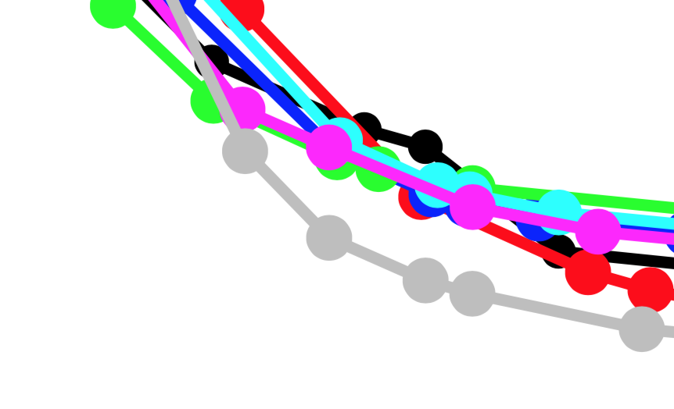
db5 vs. 3 Middle + 3 Best Random Networks

Slide 52
3 Worst Random Networks

Slide 53
db5: Missing Values (Baseline) 15-genes_28-edges_db5_Sigmoid_estimation_missing-values_L-curve

Slide 54
Random db5-Derived Network 7 15-genes_28-edges_db5-random7-fam_Sigmoid_estimation_missing-values_L-curve

Slide 55
Random db5-Derived Network 12 15-genes_28-edges_db5-random12-fam_Sigmoid_estimation_missing-values_L-curve

Slide 56
Random db5-Derived Network 31 15-genes_28-edges_db5-random31_Sigmoid_estimation_missing-values_L-curve

Slide 57
db5 vs. 3 Worst Random Networks

Slide 58
Experiment VI: Comparison of Networks db1-db6

Slide 59
db1 16-genes_36-edges_db1_Sigmoid_estimation_missing-values_L-curve

Slide 60
db2 14-gene_25-edges_db2_Sigmoid_estimation_missing-values_L-curve

Slide 61
db3 17-genes_32-edges_db3_Sigmoid_estimation_missing-values_L-curve

Slide 62
db4 14-genes_35-edges_db4_Sigmoid_estimation_missing-values_L-curve

Slide 63
db5 15-genes_28-edges_db5_Sigmoid_estimation_missing-values_L-curve

Slide 64
db6 16-genes_27-edges_db6_Sigmoid_estimation_missing-values_L-curve

Slide 65
Comparison of Networks db1-db6

Slide 66
“Mega Plot” of All L-Curves:

Slide 67
“Mega Plot” of All L-Curves

Slide 68
Compiled Results Figures

Slide 69
Missing Values Results for db5

Slide 70
Varied Optimization Parameters Results for db5

Slide 71
Varied Strain Data Results for db5

Slide 72
Varied Network Size Results for db5

Slide 73
db5 vs. 3 Best Random Networks

Slide 74
db5 vs. 3 Middle Random Networks

Slide 75
db5 vs. 3 Middle + 3 Best Random Networks
Notes:
3 Middle: rand2, rand3, rand9
3 Best: rand15, rand16, rand24
Interesting Note: Dynamics of rand 2 @ selected alpha value.

Slide 76
db5 vs. 3 Middle + 3 Best Random Networks

Slide 77
db5 vs. 3 Worst Random Networks

Slide 78
Comparison of Networks db1-db6

